Slide 1
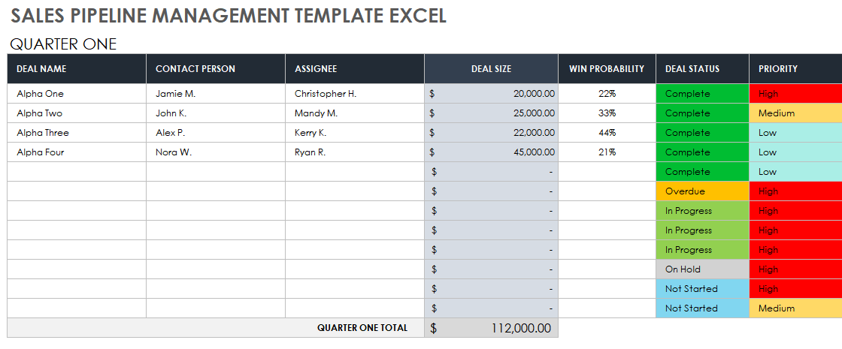
SALES PIPELINE MANAGEMENT TEMPLATE
Template begins on page 2.

Slide 2
QUARTER ONE
DEAL NAME | CONTACT PERSON | ASSIGNEE | DEAL SIZE | WIN PROBABILITY | DEAL STATUS | PRIORITY | COMMENTS
 |  |  | $0.00 | 0% | Complete | High
 |  |  | $ | 0% | Complete | Medium
 |  |  | $ | 0% | Complete | Low
 |  |  |  | 0% | Complete | Low
 |  |  |  |  | Complete | Low
 |  |  |  |  | Overdue | High
 |  |  |  |  | In Progress | High
 |  |  |  |  | In Progress | High
 |  |  |  |  | In Progress | High
 |  |  |  |  | On Hold | High
 |  |  |  |  | Not Started | High
 |  |  |  |  | Not Started | Medium
QUARTER ONE TOTAL |  |  | $0.00

Slide 3
QUARTER TWO
DEAL NAME | CONTACT PERSON | ASSIGNEE | DEAL SIZE | WIN PROBABILITY | DEAL STATUS | PRIORITY | COMMENTS
 |  |  | $0.00 | 0% | Complete | High
 |  |  | $ | 0% | Complete | Medium
 |  |  | $ | 0% | Complete | Low
 |  |  |  | 0% | Complete | Low
 |  |  |  |  | Complete | Low
 |  |  |  |  | Overdue | High
 |  |  |  |  | In Progress | High
 |  |  |  |  | In Progress | High
 |  |  |  |  | In Progress | High
 |  |  |  |  | On Hold | High
 |  |  |  |  | Not Started | High
 |  |  |  |  | Not Started | Medium
QUARTER TWO TOTAL |  |  | $0.00

Slide 4
QUARTER THREE
DEAL NAME | CONTACT PERSON | ASSIGNEE | DEAL SIZE | WIN PROBABILITY | DEAL STATUS | PRIORITY | COMMENTS
 |  |  | $0.00 | 0% | Complete | High
 |  |  | $ | 0% | Complete | Medium
 |  |  | $ | 0% | Complete | Low
 |  |  |  | 0% | Complete | Low
 |  |  |  |  | Complete | Low
 |  |  |  |  | Overdue | High
 |  |  |  |  | In Progress | High
 |  |  |  |  | In Progress | High
 |  |  |  |  | In Progress | High
 |  |  |  |  | On Hold | High
 |  |  |  |  | Not Started | High
 |  |  |  |  | Not Started | Medium
QUARTER THREE TOTAL |  |  | $0.00

Slide 5
QUARTER FOUR
DEAL NAME | CONTACT PERSON | ASSIGNEE | DEAL SIZE | WIN PROBABILITY | DEAL STATUS | PRIORITY | COMMENTS
 |  |  | $0.00 | 0% | Complete | High
 |  |  | $ | 0% | Complete | Medium
 |  |  | $ | 0% | Complete | Low
 |  |  |  | 0% | Complete | Low
 |  |  |  |  | Complete | Low
 |  |  |  |  | Overdue | High
 |  |  |  |  | In Progress | High
 |  |  |  |  | In Progress | High
 |  |  |  |  | In Progress | High
 |  |  |  |  | On Hold | High
 |  |  |  |  | Not Started | High
 |  |  |  |  | Not Started | Medium
QUARTER FOUR TOTAL |  |  | $0.00

Slide 6
NOTES
Summary information / comments

Slide 7
DISCLAIMER Any articles, templates, or information provided by Smartsheet on the website are for reference only. While we strive to keep the information up to date and correct, we make no representations or warranties of any kind, express or implied, about the completeness, accuracy, reliability, suitability, or availability with respect to the website or the information, articles, templates, or related graphics contained on the website. Any reliance you place on such information is therefore strictly at your own risk.

