Slide 1
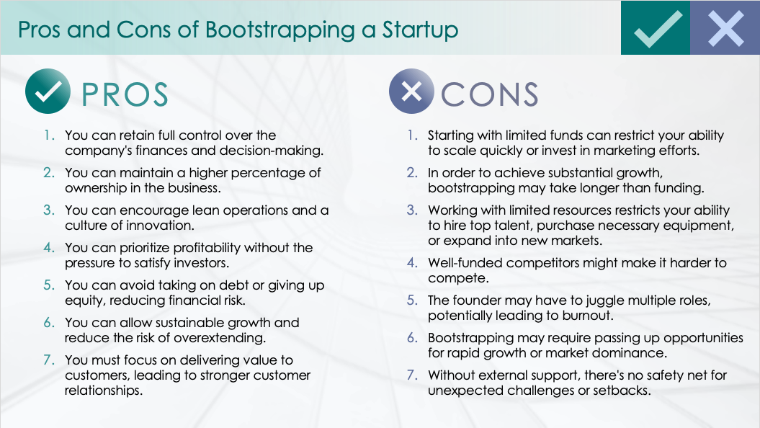
SIMPLE PROS AND CONS LIST SLIDE TEMPLATE – EXAMPLE
When to Use This Template: Use this pros and cons slide template as part of a presentation to effectively communicate the reasoning behind your choices to colleagues or stakeholders. The simple layout works for discussions, meetings, or any scenario requiring a clear visual representation of competing considerations.
Notable Template Features: The template is designed for clarity, listing positive and negative aspects of a decision or situation in a slide format. The example version of this template shows the slide filled in with the pros and cons of bootstrapping a startup.

Slide 2
Pros and Cons of Bootstrapping a Startup
PROS
CONS
You can retain full control over the company's finances and decision-making.
You can maintain a higher percentage of ownership in the business.
You can encourage lean operations and a culture of innovation.
You can prioritize profitability without the pressure to satisfy investors.
You can avoid taking on debt or giving up equity, reducing financial risk.
You can allow sustainable growth and reduce the risk of overextending.
You must focus on delivering value to customers, leading to stronger customer relationships.
Starting with limited funds can restrict your ability to scale quickly or invest in marketing efforts.
In order to achieve substantial growth, bootstrapping may take longer than funding.
Working with limited resources restricts your ability to hire top talent, purchase necessary equipment, or expand into new markets.
Well-funded competitors might make it harder to compete.
The founder may have to juggle multiple roles, potentially leading to burnout.
Bootstrapping may require passing up opportunities for rapid growth or market dominance.
Without external support, there's no safety net for unexpected challenges or setbacks.

Slide 3
Title of Situation / Items Considered
PROS
CONS
Pro One
Pro Two
Etc.
Con One
Con Two
Etc.

Slide 4
DISCLAIMER Any articles, templates, or information provided by Smartsheet on the website are for reference only. While we strive to keep the information up to date and correct, we make no representations or warranties of any kind, express or implied, about the completeness, accuracy, reliability, suitability, or availability with respect to the website or the information, articles, templates, or related graphics contained on the website. Any reliance you place on such information is therefore strictly at your own risk.

