Slide 1
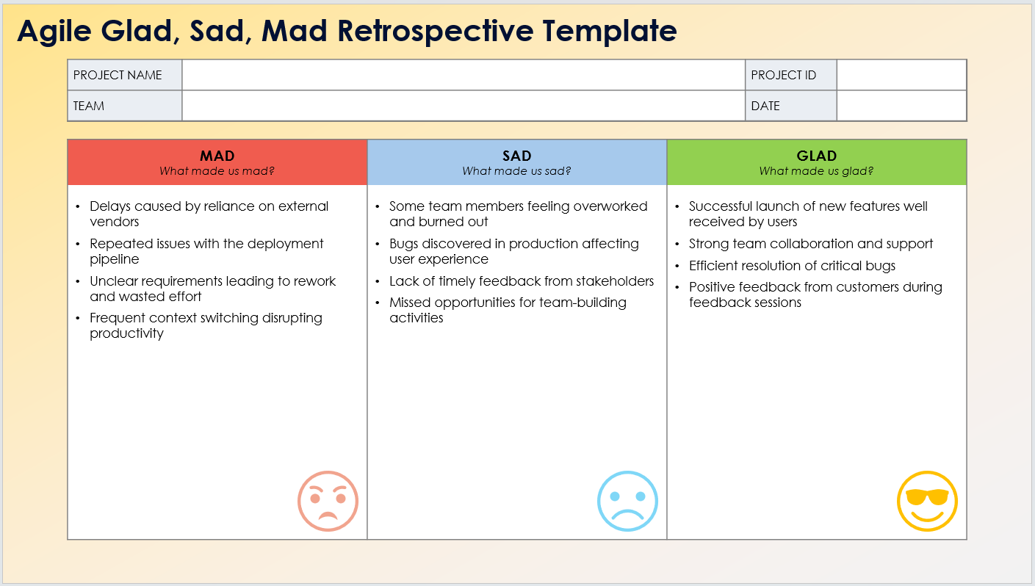
Agile Glad, Sad, Mad Retrospective Template Example
When to Use This Template: Apply this Agile glad, sad, mad retrospective template during retrospectives to discuss what made the team mad, sad, and glad during the sprint. It's useful for understanding emotional responses and team morale.
Notable Templates Features: This template includes three columns: Mad, Sad, and Glad, allowing team members to express their frustrations, disappointments, and positive experiences. This template helps in capturing emotional feedback, fostering open communication, and identifying areas for improvement.

Slide 2
Agile Glad, Sad, Mad Retrospective Template Example
PROJECT NAME |  | PROJECT ID
TEAM |  | DATE
MAD What made us mad? | SAD What made us sad? | GLAD What made us glad?
Delays caused by reliance on external vendors Repeated issues with the deployment pipeline Unclear requirements leading to rework and wasted effort Frequent context switching disrupting productivity | Some team members feeling overworked and burned out Bugs discovered in production affecting user experience Lack of timely feedback from stakeholders Missed opportunities for team-building activities | Successful launch of new features well received by users Strong team collaboration and support Efficient resolution of critical bugs Positive feedback from customers during feedback sessions

Slide 3
DISCLAIMER Any articles, templates, or information provided by Smartsheet on the website are for reference only. While we strive to keep the information up to date and correct, we make no representations or warranties of any kind, express or implied, about the completeness, accuracy, reliability, suitability, or availability with respect to the website or the information, articles, templates, or related graphics contained on the website. Any reliance you place on such information is therefore strictly at your own risk.

