Slide 1


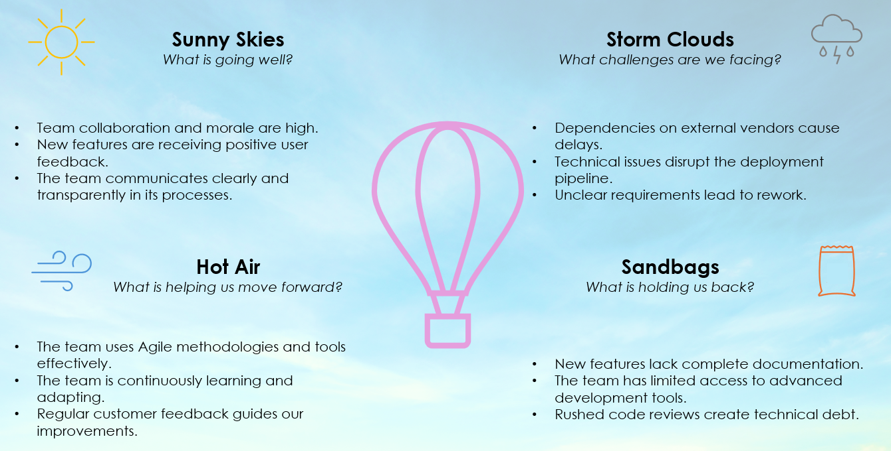
Agile Retrospective Hot Air Balloon Template
When To Use This Template:
Use this Agile retrospective hot air balloon template during sprint retrospectives to evaluate what is going well (sunny skies), what is helping the team progress (hot air), the challenges faced (storm clouds), and what is holding the team back (sandbags). It's ideal for visualizing both positive and negative aspects impacting the team.
Notable Templates Features:
This template features four key sections: sunny skies, hot air, storm clouds, and sandbags, providing a comprehensive framework for discussing team progress, support factors, obstacles, and hindrances. This template helps teams collaboratively identify successes, support mechanisms, challenges, and areas for improvement.

Slide 2






Agile Retrospective Hot Air Balloon Template
Sunny Skies What is going well?
Text 1 Text 2 Text 3
Hot Air What is helping us move forward?
Text 1 Text 2 Text 3
Storm Clouds What challenges are we facing?
 | Text 1 Text 2 Text 3
Sandbags What is holding us back?
 | Text 1 Text 2 Text 3

Slide 3
DISCLAIMER Any articles, templates, or information provided by Smartsheet on the website are for reference only. While we strive to keep the information up to date and correct, we make no representations or warranties of any kind, express or implied, about the completeness, accuracy, reliability, suitability, or availability with respect to the website or the information, articles, templates, or related graphics contained on the website. Any reliance you place on such information is therefore strictly at your own risk.

