Slide 1

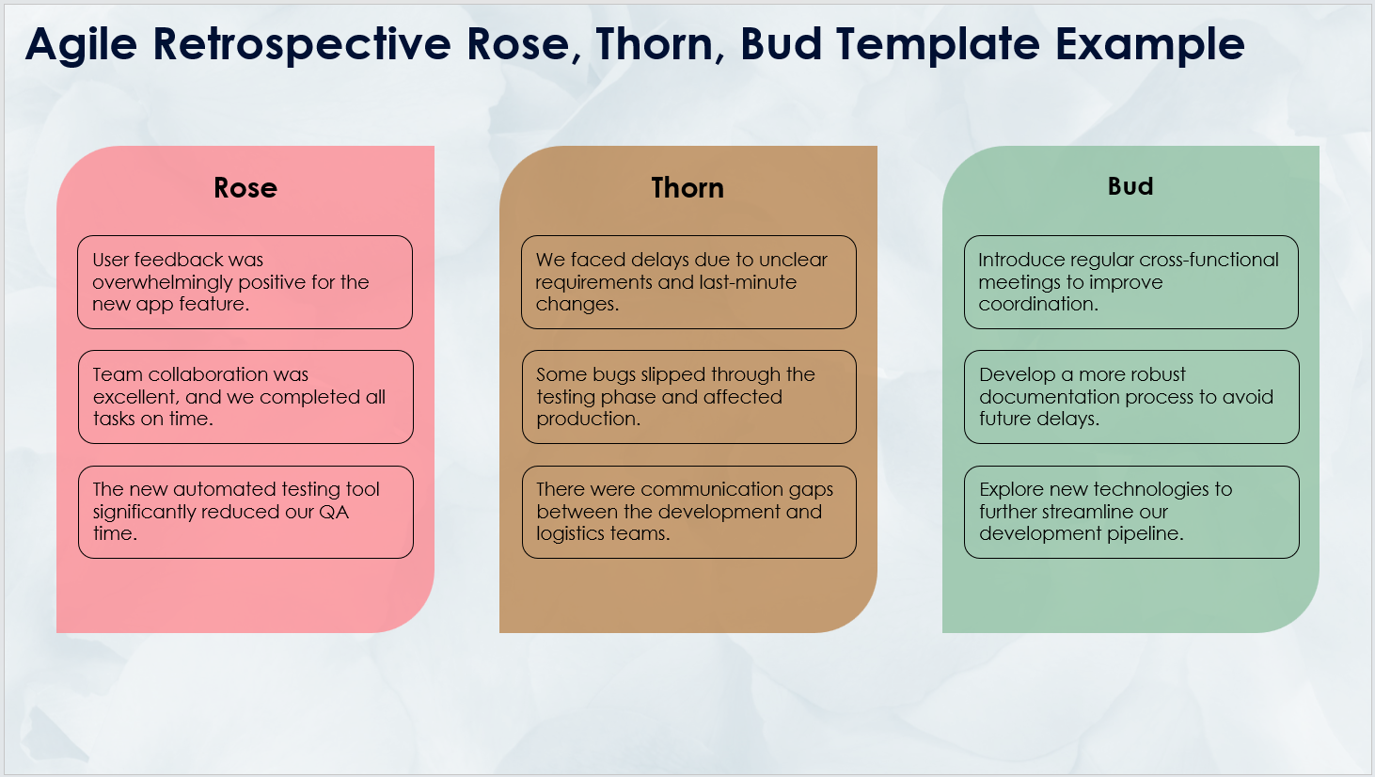
Agile Retrospective Rose, Thorn, Bud Template
When To Use This Template:
Employ this Agile retrospective rose, thorn, bud template during sprint retrospectives to evaluate the positives (roses), negatives (thorns), and opportunities for improvement or new ideas (buds). It's perfect for reflecting on team performance and planning for future growth.
Notable Templates Features:
This template features three columns — Rose, Thorn, and Bud — where team members can identify successes, challenges, and areas for improvement. This template encourages open discussion and collaborative action planning for continuous improvement.

Slide 2
Agile Retrospective Rose, Thorn, Bud Template
Rose
Identify what went well during the sprint. These are the successes and positive aspects of the team's work.
Thorn
Identify what didn't go well. These are the obstacles, challenges, and issues the team faced.
Bud
Identify areas for improvement or new ideas. These are opportunities for growth and innovation.

Slide 3
Agile Retrospective Rose, Thorn, Bud Template
Rose
Thorn
Bud
Enter text
Enter text
Enter text
Enter text
Enter text
Enter text
Enter text
Enter text
Enter text
Enter text
Enter text
Enter text

Slide 4
DISCLAIMER Any articles, templates, or information provided by Smartsheet on the website are for reference only. While we strive to keep the information up to date and correct, we make no representations or warranties of any kind, express or implied, about the completeness, accuracy, reliability, suitability, or availability with respect to the website or the information, articles, templates, or related graphics contained on the website. Any reliance you place on such information is therefore strictly at your own risk.

