Slide 1

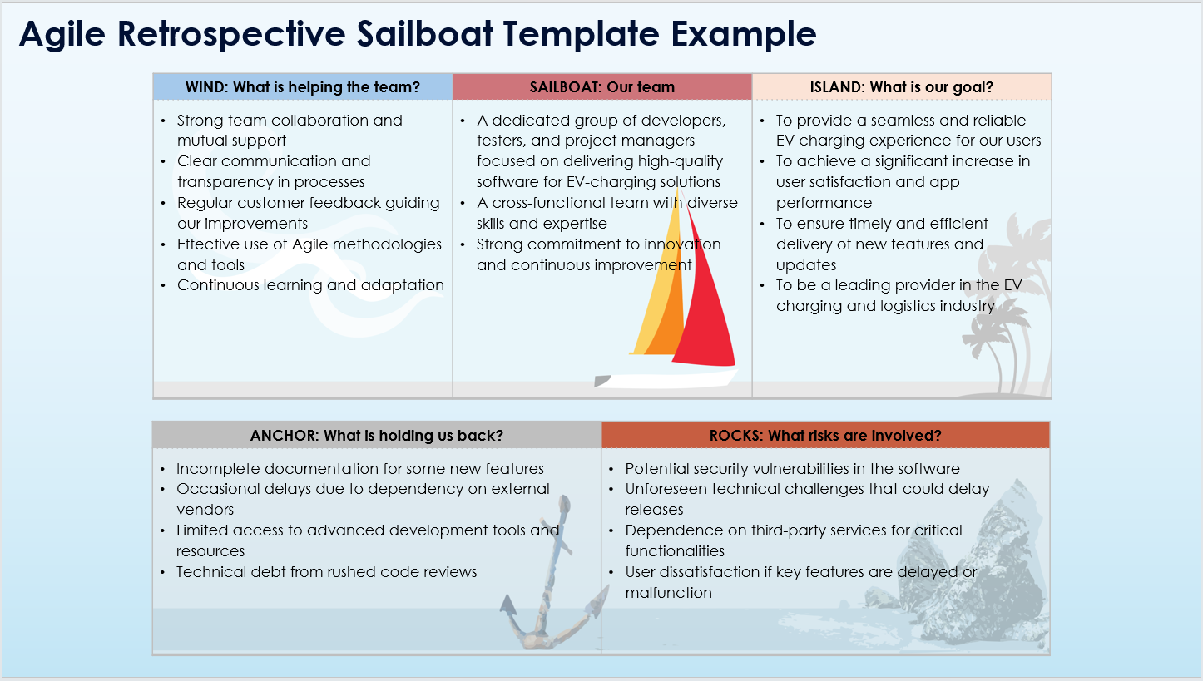
Agile Retrospective Sailboat Template
When To Use This Template:
Use this Agile retrospective sailboat template during sprint retrospectives to assess what is helping the team (Wind), the team's status (Sailboat), the team's goals (Island), obstacles (Anchor), and potential risks (Rocks). It's perfect for visualizing team dynamics and understanding both positive and negative influences.
Notable Templates Features:
Features five interactive sections: Wind, Sailboat, Island, Anchor, and Rocks, providing a comprehensive view of team performance and challenges. This template aids in collaboratively identifying strengths, goals, impediments, and risks, fostering actionable insights for continuous improvement.

Slide 2
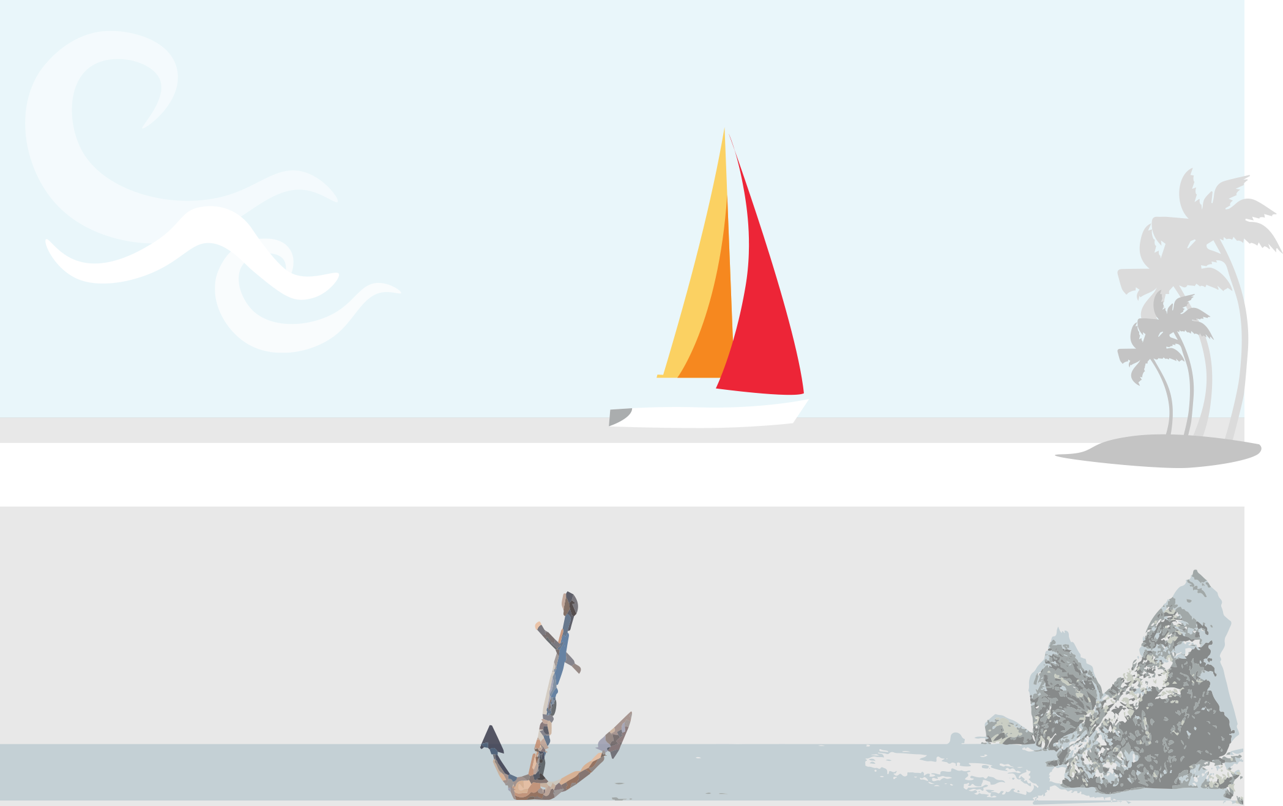
Agile Retrospective Sailboat Template
WIND: What is helping the team? | SAILBOAT: Our team | ISLAND: What is our goal?
ANCHOR: What is holding us back? | ROCKS: What risks are involved?

Slide 3
DISCLAIMER Any articles, templates, or information provided by Smartsheet on the website are for reference only. While we strive to keep the information up to date and correct, we make no representations or warranties of any kind, express or implied, about the completeness, accuracy, reliability, suitability, or availability with respect to the website or the information, articles, templates, or related graphics contained on the website. Any reliance you place on such information is therefore strictly at your own risk.

