Slide 1

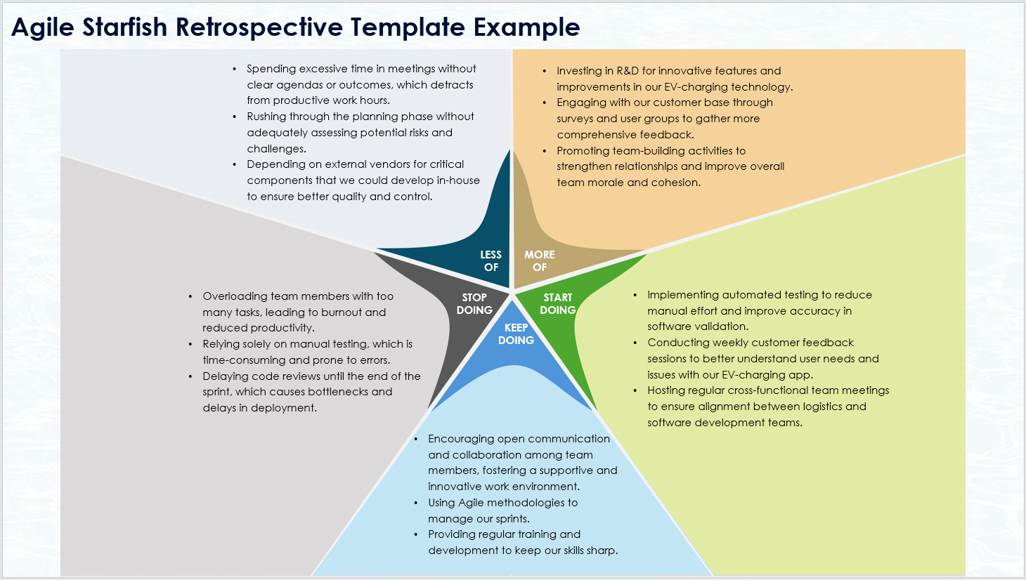
Agile Starfish Retrospective Template
When To Use This Template:
Utilize this agile starfish retrospective template during sprint retrospectives to evaluate team activities and determine what to do less of, more of, start doing, keep doing, and stop doing.
Notable Templates Features:
This template features five distinct sections: Less of, More of, Start Doing, Keep Doing, and Stop Doing, facilitating a comprehensive analysis of team practices and helping to drive continuous improvement.

Slide 2
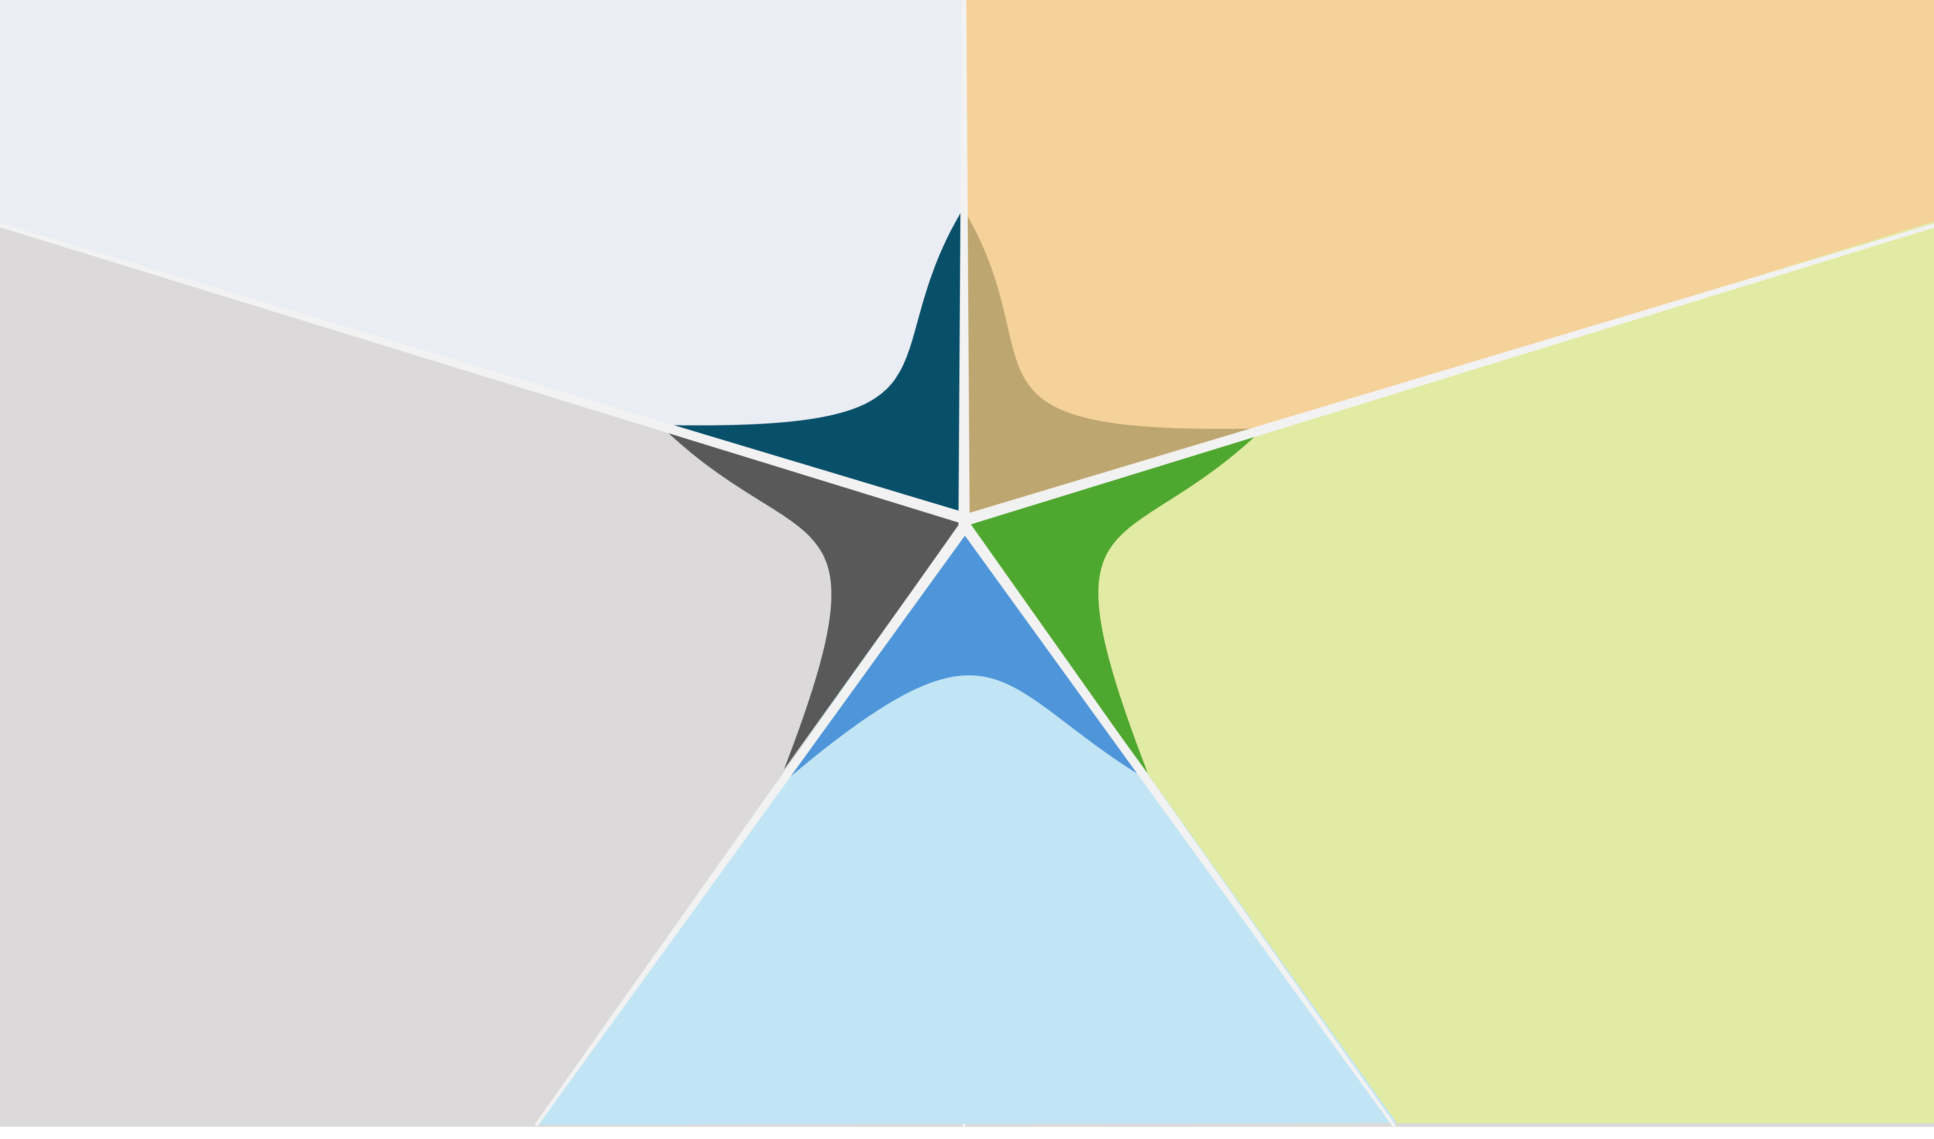
Agile Starfish Retrospective Template
Less of 1
Less of 2
Less of 3
More of 1
More of 2
More of 3
LESS
OF
MORE
OF
Stop doing 1
Stop doing 2
Stop doing 3
STOP
DOING
START
DOING
Start doing 1
Start doing 2
Start doing 3
KEEP
DOING
Keep doing 1
Keep doing 2
Keep doing 3

Slide 3
DISCLAIMER Any articles, templates, or information provided by Smartsheet on the website are for reference only. While we strive to keep the information up to date and correct, we make no representations or warranties of any kind, express or implied, about the completeness, accuracy, reliability, suitability, or availability with respect to the website or the information, articles, templates, or related graphics contained on the website. Any reliance you place on such information is therefore strictly at your own risk.

