Slide 1

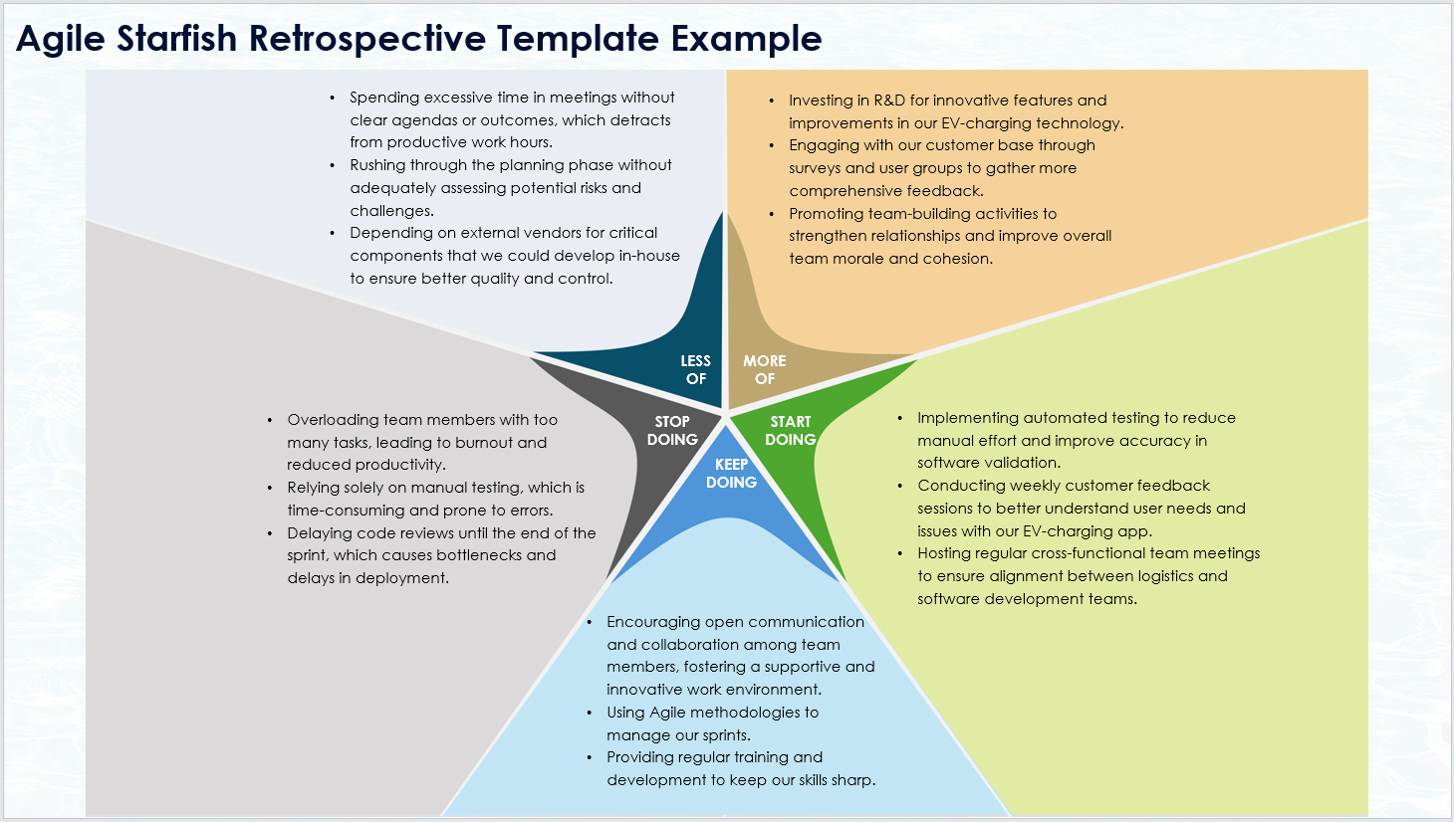
Agile Starfish Retrospective Template Example
When To Use This Template:
Utilize this agile starfish retrospective template during sprint retrospectives to evaluate team activities and determine what to do less of, more of, start doing, keep doing, and stop doing.
Notable Templates Features:
This template features five distinct sections: Less of, More of, Start Doing, Keep Doing, and Stop Doing, facilitating a comprehensive analysis of team practices and helping to drive continuous improvement.

Slide 2

Agile Starfish Retrospective Template Example
Spending excessive time in meetings without clear agendas or outcomes, which detracts from productive work hours.
Rushing through the planning phase without adequately assessing potential risks and challenges.
Depending on external vendors for critical components that we could develop in-house to ensure better quality and control.
Investing in R&D for innovative features and improvements in our EV-charging technology.
Engaging with our customer base through surveys and user groups to gather more comprehensive feedback.
Promoting team-building activities to strengthen relationships and improve overall team morale and cohesion.
LESS
OF
MORE
OF
Overloading team members with too many tasks, leading to burnout and reduced productivity.
Relying solely on manual testing, which is time-consuming and prone to errors.
Delaying code reviews until the end of the sprint, which causes bottlenecks and delays in deployment.
STOP
DOING
START
DOING
Implementing automated testing to reduce manual effort and improve accuracy in software validation.
Conducting weekly customer feedback sessions to better understand user needs and issues with our EV-charging app.
Hosting regular cross-functional team meetings to ensure alignment between logistics and software development teams.
KEEP
DOING
Encouraging open communication and collaboration among team members, fostering a supportive and innovative work environment.
Using Agile methodologies to manage our sprints.
Providing regular training and development to keep our skills sharp.

Slide 3
DISCLAIMER Any articles, templates, or information provided by Smartsheet on the website are for reference only. While we strive to keep the information up to date and correct, we make no representations or warranties of any kind, express or implied, about the completeness, accuracy, reliability, suitability, or availability with respect to the website or the information, articles, templates, or related graphics contained on the website. Any reliance you place on such information is therefore strictly at your own risk.

