Slide 1

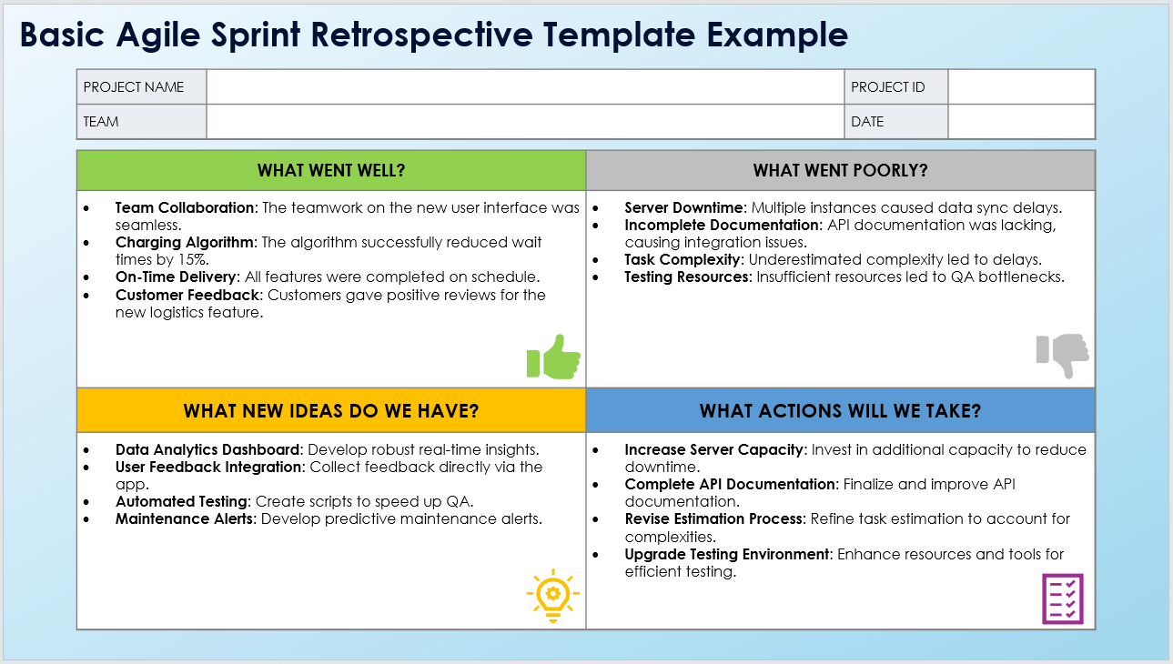
Basic Agile Sprint Retrospective Template Example
When To Use This Template:
Use this basic Agile sprint retrospective template at the end of each sprint to reflect on what went well, identify areas for improvement, brainstorm new ideas, and plan actionable steps for the next sprint.
Notable Templates Features:
This template includes sections for What Went Well? (thumbs up), What Went Poorly? (thumbs down), What New Ideas Do We Have? (lightbulb icon), and What Actions Will We Take? (list icon). This template is suitable for universal Agile practices across all formats.

Slide 2




Basic Agile Sprint Retrospective Template Example
PROJECT NAME |  | PROJECT ID
TEAM |  | DATE
WHAT WENT WELL? | WHAT WENT POORLY?
Team Collaboration: The teamwork on the new user interface was seamless. Charging Algorithm: The algorithm successfully reduced wait times by 15%. On-Time Delivery: All features were completed on schedule. Customer Feedback: Customers gave positive reviews for the new logistics feature. | Server Downtime: Multiple instances caused data sync delays. Incomplete Documentation: API documentation was lacking, causing integration issues. Task Complexity: Underestimated complexity led to delays. Testing Resources: Insufficient resources led to QA bottlenecks.
WHAT NEW IDEAS DO WE HAVE? | WHAT ACTIONS WILL WE TAKE?
Data Analytics Dashboard: Develop robust real-time insights. User Feedback Integration: Collect feedback directly via the app. Automated Testing: Create scripts to speed up QA. Maintenance Alerts: Develop predictive maintenance alerts. | Increase Server Capacity: Invest in additional capacity to reduce downtime. Complete API Documentation: Finalize and improve API documentation. Revise Estimation Process: Refine task estimation to account for complexities. Upgrade Testing Environment: Enhance resources and tools for efficient testing.

Slide 3
DISCLAIMER Any articles, templates, or information provided by Smartsheet on the website are for reference only. While we strive to keep the information up to date and correct, we make no representations or warranties of any kind, express or implied, about the completeness, accuracy, reliability, suitability, or availability with respect to the website or the information, articles, templates, or related graphics contained on the website. Any reliance you place on such information is therefore strictly at your own risk.

