Slide 1

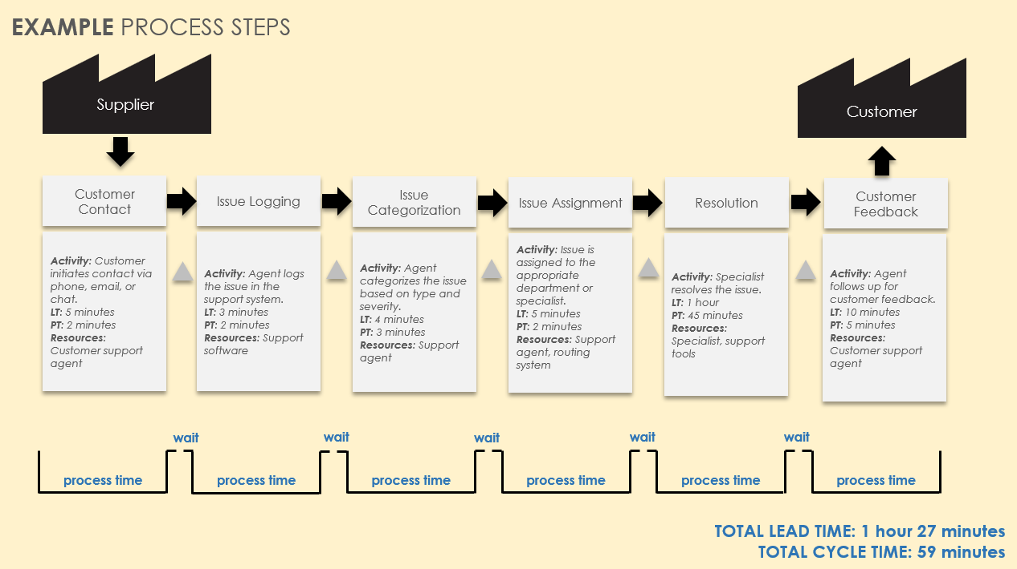
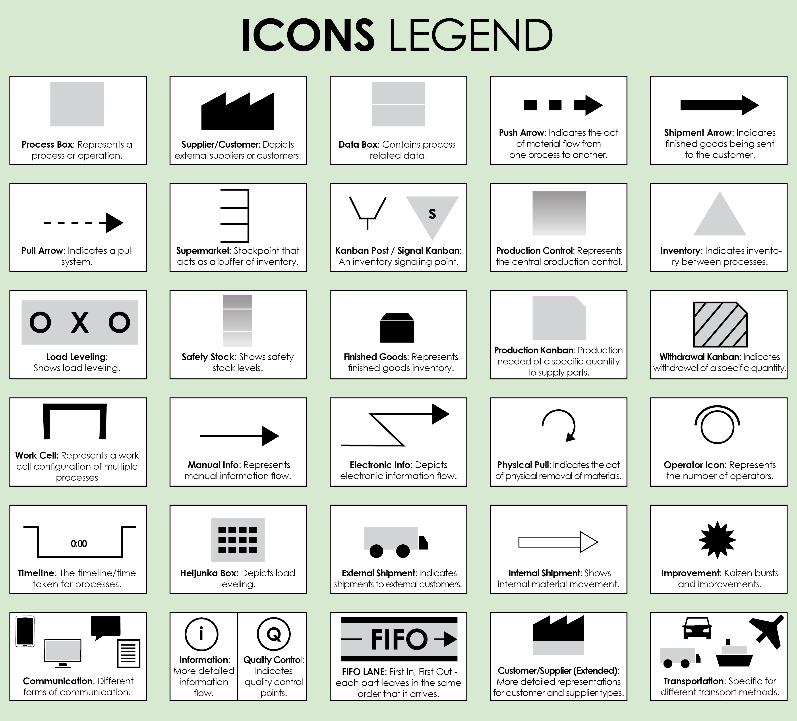
Basic Value Stream Map Slide Template Example
TITLE: Customer Support Process VSM
For descriptions, see VSM Icons Legend on Slide 5.
To create your own VSM, copy and paste icons from the VSM Icons on Slide 6.

Slide 2


EXAMPLE PROCESS STEPS
Supplier
Customer
Customer Contact
Issue Logging
Issue Categorization
Issue Assignment
Resolution
Customer Feedback
Activity: Customer initiates contact via phone, email, or chat.
LT: 5 minutes
PT: 2 minutes
Resources: Customer support agent
Activity: Agent logs the issue in the support system.
LT: 3 minutes
PT: 2 minutes
Resources: Support software
Activity: Agent categorizes the issue based on type and severity.
LT: 4 minutes
PT: 3 minutes
Resources: Support agent
Activity: Issue is assigned to the appropriate department or specialist.
LT: 5 minutes
PT: 2 minutes
Resources: Support agent, routing system
Activity: Specialist resolves the issue.
LT: 1 hour
PT: 45 minutes
Resources: Specialist, support tools
Activity: Agent follows up for customer feedback.
LT: 10 minutes
PT: 5 minutes
Resources: Customer support agent
wait
wait
wait
wait
wait
process time
process time
process time
process time
process time
process time
NOTES
Bottlenecks: Issue assignment and resolution stages often face delays.
TOTAL LEAD TIME: 1 hour 27 minutes
TOTAL CYCLE TIME: 59 minutes
Recommendations: Implement automated issue categorization and assignment to reduce lead times.

Slide 3
PROCESS STEPS
To create your own VSM, copy and paste icons from the VSM Icons on Slide 6.
TOTAL LEAD TIME: 0 hours 00 minutes
TOTAL CYCLE TIME: 0 hours 00 minutes

Slide 4
NOTES
Bottlenecks: Description ...
Recommendations: Description ...

Slide 5
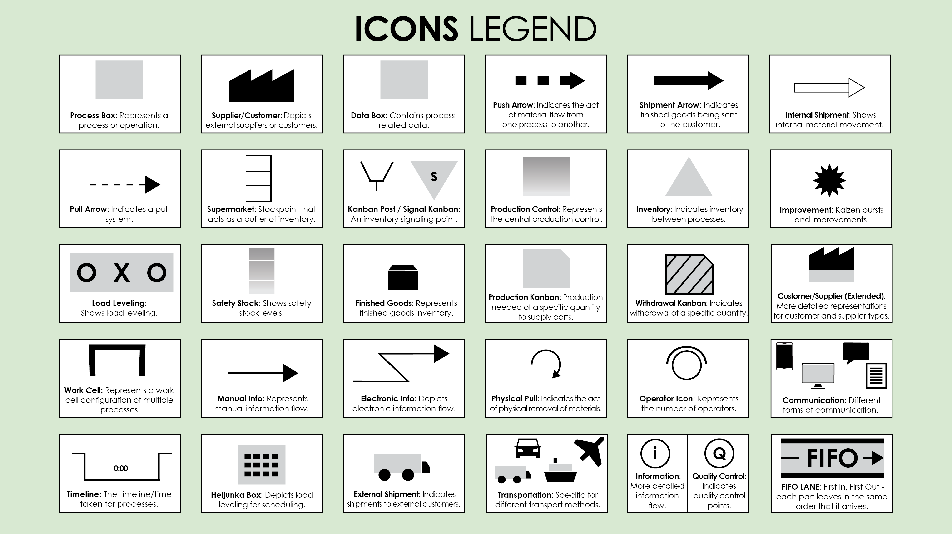

Slide 6
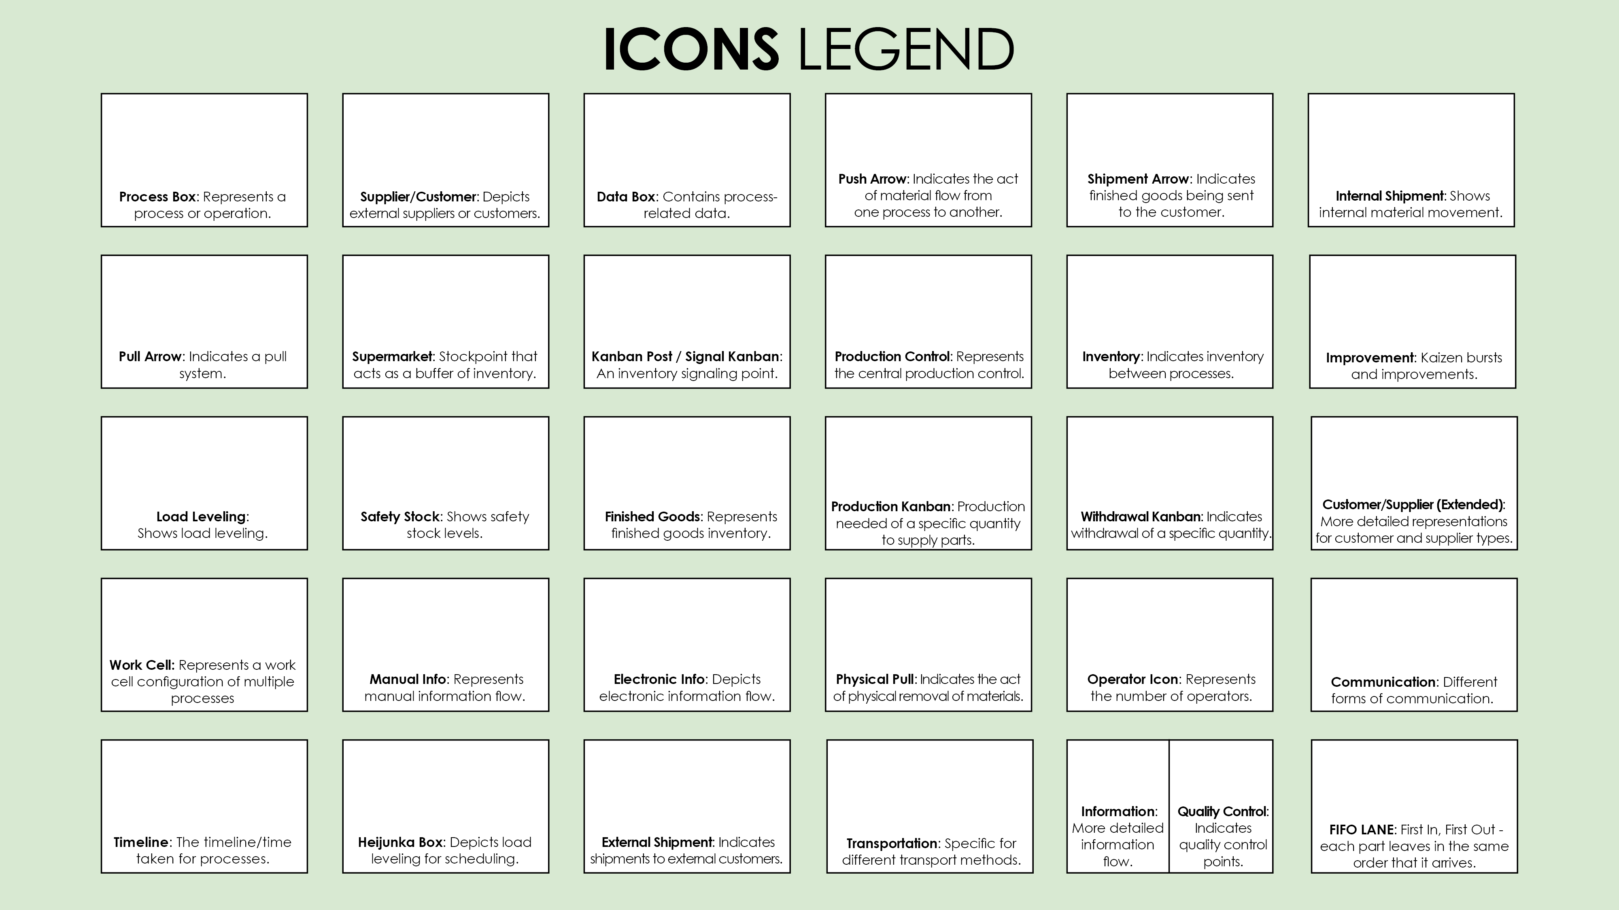


Copy and paste the icons below to create your own VSM.

Slide 7
DISCLAIMER Any articles, templates, or information provided by Smartsheet on the website are for reference only. While we strive to keep the information up to date and correct, we make no representations or warranties of any kind, express or implied, about the completeness, accuracy, reliability, suitability, or availability with respect to the website or the information, articles, templates, or related graphics contained on the website. Any reliance you place on such information is therefore strictly at your own risk.

