Slide 1


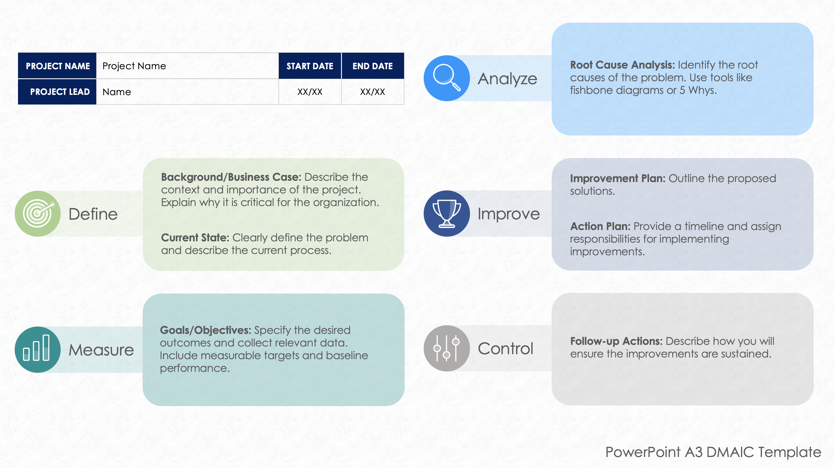
PowerPoint A3 DMAIC Template

Slide 2





PROJECT NAME | Project Name | START DATE | END DATE
PROJECT LEAD | Name | XX/XX | XX/XX
Root Cause Analysis: Identify the root causes of the problem. Use tools like fishbone diagrams or 5 Whys.
Analyze
Background/Business Case: Describe the context and importance of the project. Explain why it is critical for the organization.
Current State: Clearly define the problem and describe the current process.
Improvement Plan: Outline the proposed solutions.
Action Plan: Provide a timeline and assign responsibilities for implementing improvements.
Define
Improve
Goals/Objectives: Specify the desired outcomes and collect relevant data. Include measurable targets and baseline performance.
Measure
Control
Follow-up Actions: Describe how you will ensure the improvements are sustained.
PowerPoint A3 DMAIC Template

Slide 3
DISCLAIMER Any articles, templates, or information provided by Smartsheet on the website are for reference only. While we strive to keep the information up to date and correct, we make no representations or warranties of any kind, express or implied, about the completeness, accuracy, reliability, suitability, or availability with respect to the website or the information, articles, templates, or related graphics contained on the website. Any reliance you place on such information is therefore strictly at your own risk.

