Slide 1

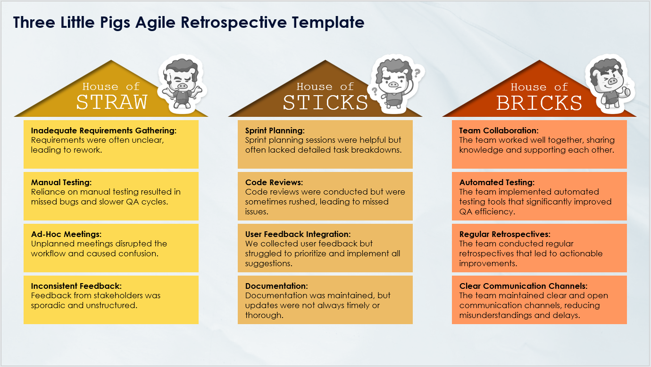
Three Little Pigs Agile Retrospective Template Example
When To Use This Template:
Apply this Three Little Pigs Agile retrospective template during sprint retrospectives to evaluate practices that were weak (House of Straw), moderately effective (House of Sticks), and strong (House of Bricks). This template is excellent for identifying and reinforcing successful practices while addressing weaknesses.
Notable Templates Features:
This template features three sections: House of Straw, House of Sticks, and House of Bricks, allowing teams to categorize processes based on their effectiveness. This template promotes detailed analysis and structured discussions to enhance team performance and process strength.

Slide 2



Three Little Pigs Agile Retrospective Template Example
House of
House of
House of
STRAW
STICKS
BRICKS
List the practices or processes that were weak or ineffective during the sprint.
Identify the practices or processes that were somewhat effective but need strengthening.
Highlight the practices or processes that were strong and contributed significantly to the team's success.

Slide 3
Three Little Pigs Agile Retrospective Template Example
House of
House of
House of
STRAW
STICKS
BRICKS
Inadequate Requirements Gathering:
Requirements were often unclear, leading to rework.
Sprint Planning:
Sprint planning sessions were helpful but often lacked detailed task breakdowns.
Team Collaboration:
The team worked well together, sharing knowledge and supporting each other.
Manual Testing:
Reliance on manual testing resulted in missed bugs and slower QA cycles.
Code Reviews:
Code reviews were conducted but were sometimes rushed, leading to missed issues.
Automated Testing:
The team implemented automated testing tools that significantly improved QA efficiency.
Ad-Hoc Meetings:
Unplanned meetings disrupted the workflow and caused confusion.
User Feedback Integration:
We collected user feedback but struggled to prioritize and implement all suggestions.
Regular Retrospectives:
The team conducted regular retrospectives that led to actionable improvements.
Inconsistent Feedback:
Feedback from stakeholders was sporadic and unstructured.
Documentation:
Documentation was maintained, but updates were not always timely or thorough.
Clear Communication Channels:
The team maintained clear and open communication channels, reducing misunderstandings and delays.

Slide 4
DISCLAIMER Any articles, templates, or information provided by Smartsheet on the website are for reference only. While we strive to keep the information up to date and correct, we make no representations or warranties of any kind, express or implied, about the completeness, accuracy, reliability, suitability, or availability with respect to the website or the information, articles, templates, or related graphics contained on the website. Any reliance you place on such information is therefore strictly at your own risk.

