Slide 1
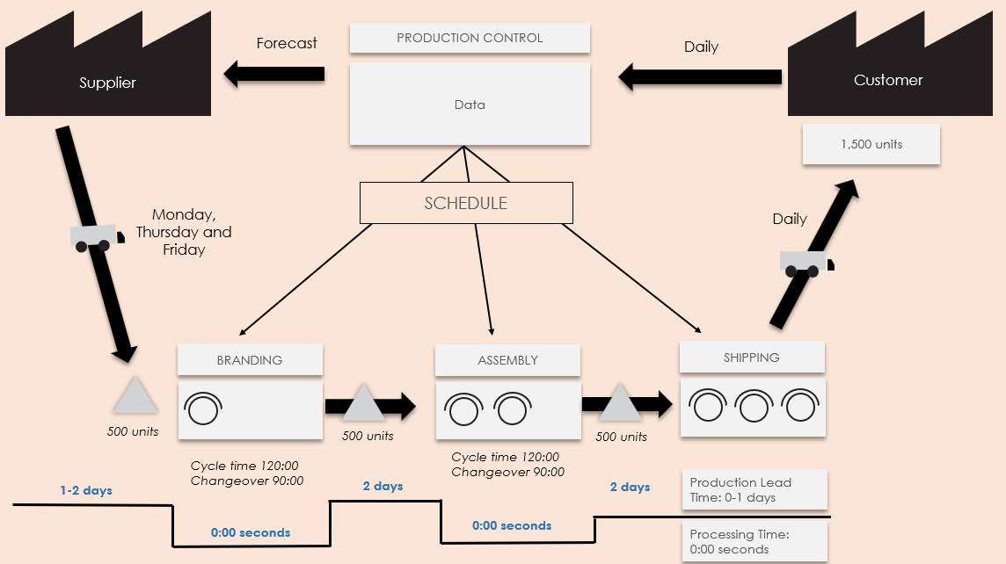
Value Stream Current State Map Template Example
Use this map to illustrate the current state of a process flow, identify inefficiencies, and show where there is room for improvement in the workflow process.
For descriptions, see VSM Icons Legend on Slide 5.
To create your own VSM, copy and paste icons from the VSM Icons on Slide 6.

Slide 2
Forecast
PRODUCTION CONTROL
Daily
Supplier
Data
Customer
1,500 units
SCHEDULE
Monday, Thursday and Friday
Daily
BRANDING
ASSEMBLY
SHIPPING
500 units
500 units
500 units
Cycle time 120:00
Changeover 90:00
Cycle time 120:00
Changeover 90:00
1-2 days
2 days
2 days
Production Lead Time: 0-1 days
Value Stream Current State Map Template Example
0:00 seconds
0:00 seconds
Processing Time: 0:00 seconds

Slide 3
Value Stream Current State Map
To create your own VSM, copy and paste icons from the VSM Icons on Slide 6.

Slide 4
NOTES

Slide 6
Copy and paste the icons below to create your own VSM.

Slide 7
DISCLAIMER Any articles, templates, or information provided by Smartsheet on the website are for reference only. While we strive to keep the information up to date and correct, we make no representations or warranties of any kind, express or implied, about the completeness, accuracy, reliability, suitability, or availability with respect to the website or the information, articles, templates, or related graphics contained on the website. Any reliance you place on such information is therefore strictly at your own risk.

