Slide 1

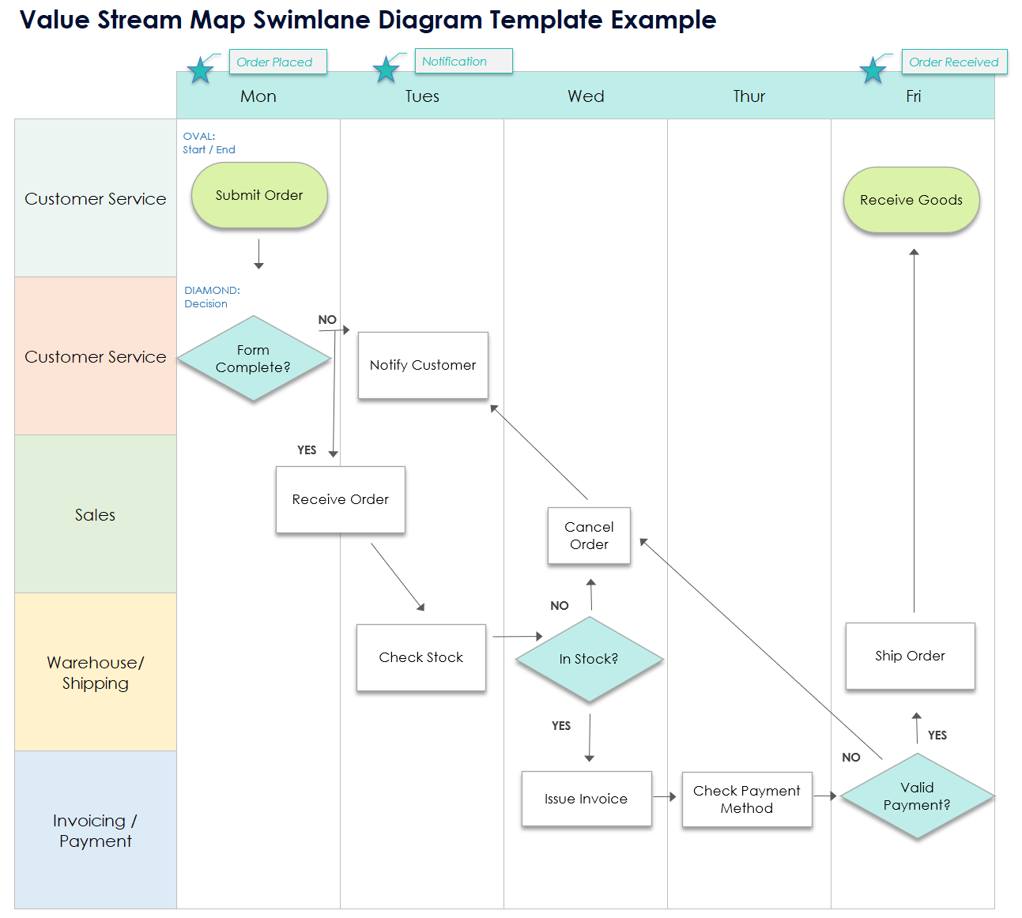
Value Stream Map Swimlane Diagram Template Example

Slide 2
Example
 | Mon | Tues | Wed | Thur | Fri
Customer Service
Customer Service
Sales
Warehouse/ Shipping
Invoicing / Payment
Order Placed
Notification
Order Received
OVAL:
Start / End
Submit Order
Receive Goods
DIAMOND:
Decision
NO
Notify Customer
Form Complete?
YES
Cancel Order
Receive Order
NO
Ship Order
Check Stock
In Stock?
YES
NO
YES
Valid Payment?
Issue Invoice
Check Payment Method

Slide 3
 | Mon | Tues | Wed | Thur | Fri
Customer Service
Customer Service
Sales
Warehouse/ Shipping
Invoicing / Payment
Milestone
Milestone
Milestone
OVAL:
Start / End
Start
End Step
DIAMOND:
Decision
NO
Process Step
Decision
(Yes or No
Question)
YES
Cancel Order
Process Step
NO
Process Step
Process Step
In Stock?
YES
NO
YES
Decision
(Yes or No
Question)
Process Step
Process Step

Slide 4
DISCLAIMER Any articles, templates, or information provided by Smartsheet on the website are for reference only. While we strive to keep the information up to date and correct, we make no representations or warranties of any kind, express or implied, about the completeness, accuracy, reliability, suitability, or availability with respect to the website or the information, articles, templates, or related graphics contained on the website. Any reliance you place on such information is therefore strictly at your own risk.

