Slide 1
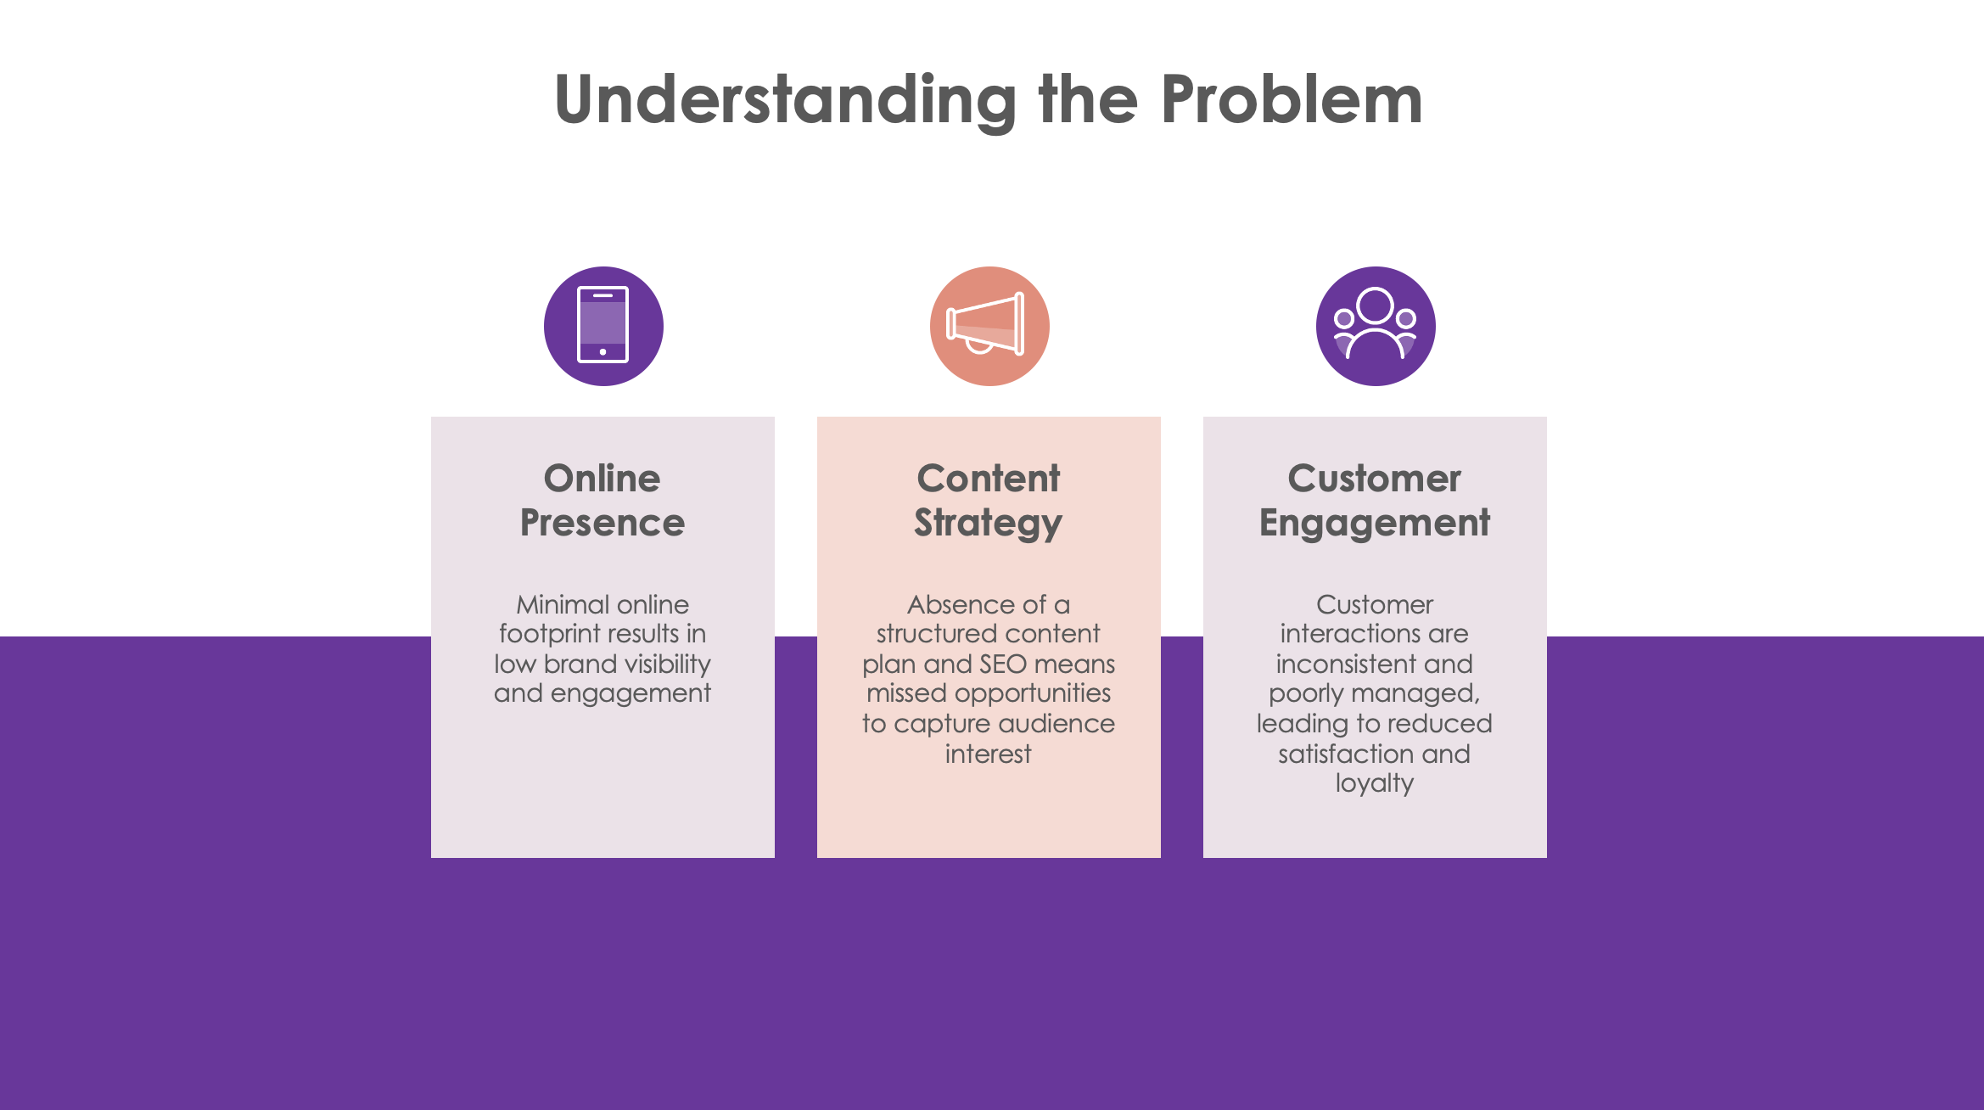
PowerPoint Consulting Proposal Presentation Sample Template

Slide 2
Title of Presentation
Presented by Name
XX.XX.XXXX

Slide 3
Table of Contents
01
02
03
Sample Text
Sample Text
Sample Text
04
05
06
Sample Text
Sample Text
Sample Text

Slide 4
Our Company
Sample “about us” text.

Slide 5
Understanding the Problem
Online Presence
Sample text
Content Strategy
Sample text
Customer Engagement
Sample text

Slide 6
Our Solutions
Enhance Digital Presence
Sample text
Revamp Content Strategy
Sample text
Streamline Customer Engagement
Sample text

Slide 7
Main Competitors
Competitor 1
Competitor 2
Competitor 3

Slide 8
Our Process
1
2
3
4
Sample Step: Sample text
Sample Step: Sample text
Sample Step: Sample text
Sample Step: Sample text

Slide 9
Market Research
XX
XX
XX
XX
XX
XX
Category 1
Category 2
Category 3

Slide 10
Target
Gender
Average Spend Per Customer
XX%
XX%
$XX,XXX
Male
Female
Category
Age
Category
20-35
35-45
45-50
Category

Slide 11
Our Consultants
Name
Position
Sample background text.
Name
Position
Sample background text.
Name
Position
Sample background text.

Slide 12
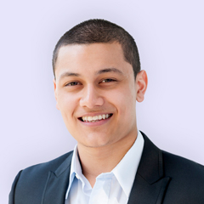
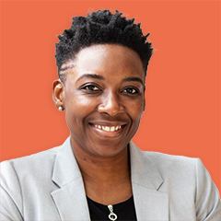
Testimonials
Sample quote text.
Name
Position Title
Sample quote text.
Name
Position Title

Slide 13
Awards
Sample Text
Sample text.
Sample Text
Sample text.
Sample Text
Sample text.

Slide 14
Goals
Goal Sample Text
Sample text
1
Goal Sample Text
Sample text
2
Goal Sample Text
Sample text
3
Goal Sample Text
Sample text
4

Slide 15
Thank You
name@email.com
(123) 456-7890
website.com

Slide 16
Innovare Consulting
Presented by Devon Gomez
XX.XX.XXXX

Slide 17
Table of Contents
01
02
03
Sample Text
Sample Text
Sample Text
04
05
06
Sample Text
Sample Text
Sample Text

Slide 18
Our Company
Innovare Consulting is your partner in innovation and strategic growth. As a forward-thinking consulting firm, we specialize in delivering tailored solutions to help businesses navigate complex challenges and seize new opportunities.
Founded by a team of industry veterans with expertise across technology, marketing, and operations, Innovare Consulting is dedicated to driving tangible results for our clients. We offer customized strategies to boost market presence, optimize performance, and foster sustainable growth.

Slide 19
Understanding the Problem
Online Presence
Minimal online footprint results in low brand visibility and engagement
Content Strategy
Absence of a structured content plan and SEO means missed opportunities to capture audience interest
Customer Engagement
Customer interactions are inconsistent and poorly managed, leading to reduced satisfaction and loyalty

Slide 20
Our Solutions
Enhance Digital Presence
Develop and implement a comprehensive digital marketing strategy to increase brand visibility and engagement
Revamp Content Strategy
Create a structured content marketing plan with high-quality, SEO-optimized content that addresses industry trends
Streamline Customer Engagement
Implement a unified customer relationship management (CRM) system to improve communication, manage interactions, and enhance customer experience

Slide 21
Main Competitors
Competitor 1
Competitor 2
Competitor 3

Slide 22
Our Process
1
2
3
4
Sample Step: Sample text
Sample Step: Sample text
Sample Step: Sample text
Sample Step: Sample text

Slide 23
Market Research
XX
XX
XX
XX
XX
XX
Category 1
Category 2
Category 3

Slide 24
Target
Gender
Average Spend Per Customer
XX%
XX%
$50,000
Male
Female
Travel
Age
Health
20–35
35–45
45–50
Family

Slide 25
Our Consultants
Victoria Pearson
Strategic Consultant
Victoria has extensive experience in market analysis and business strategy. She specializes in identifying growth opportunities and developing actionable plans to drive client success.
Jonathon Wong
Digital Marketing Specialist
Jonathon focuses on enhancing online presence and engagement. His expertise includes crafting targeted digital campaigns, optimizing content for SEO, and leveraging data analytics to boost brand visibility.
Brooklyn Jansen
Customer Experience Manager
Brooklyn is dedicated to improving client interactions and satisfaction. Her role involves designing and implementing strategies to streamline customer engagement and managing CRM systems.

Slide 26
Testimonials
Sample quote text.
Name
Position Title
Sample quote text.
Name
Position Title

Slide 27
Awards
Sample Text
Sample text.
Sample Text
Sample text.
Sample Text
Sample text.

Slide 28
Goals
Boost Online Presence by 30%
Increase the digital footprint by enhancing website and social media profiles, as well as executing targeted digital marketing campaigns
1
Increase Content Engagement by 25%
Create and roll out a detailed content marketing strategy that includes SEO-optimized blog posts, industry-focused articles, and case studies
2
Increase Customer Satisfaction Scores by 20%
Deploy a new CRM system to centralize customer data and improve interaction management
3
Increase Customer Retention by 20%
Initiate a customer engagement program that includes personalized communication strategies and loyalty rewards
4

Slide 29
Thank You
devongomez@email.com
(123) 456-7890
innovareconsulting.com

Slide 30
DISCLAIMER Any articles, templates, or information provided by Smartsheet on the website are for reference only. While we strive to keep the information up to date and correct, we make no representations or warranties of any kind, express or implied, about the completeness, accuracy, reliability, suitability, or availability with respect to the website or the information, articles, templates, or related graphics contained on the website. Any reliance you place on such information is therefore strictly at your own risk.

